Slide 1

Machine Learning for Home Loan Predictions
Name: Manisha Karnati
ID: VZ42698
Subject: Intro To Data Analysis and Machine Learning
Instructor: Masood Soroush

Slide 2
CONTENTS
Introduction
Methodology
Algorithm Selection
Results and Findings
Conclusion

Slide 3
INTRODUCTION
"Machine Learning for Home Loan Predictions" is an interesting issue in data science and finance. It applies powerful machine learning algorithms to ensure accurate and informed lending judgments in the complicated mortgage lending landscape.
This topic is concerned with ensuring that lenders make appropriate house loan application selections, resolving human bias and anomalies in traditional lending procedures, and thereby lowering financial risks.
Machine learning in the financing business greatly enhances the approval process by using applicant data for predictive modeling. This improves accuracy, lowers default risk, supports ethical lending practices, and promotes financial inclusion, making house ownership more accessible.

Slide 4
METHODOLOGY
DATA SOURCE: KAGGLE- "C:\Users\14438\Downloads\loanapplicants.csv“
DATA PREPROCESSING is a crucial step in the data analysis pipeline of a project, assuring data quality and reliability before it is utilized in machine learning models.
Handling Missing Values
Checking for Duplicate Rows
Data Type Checking
Data Exploration
For a thorough examination of loan approval outcomes, this study integrates logistic regression, random forest classification, and linear regression.
These machine learning techniques give lenders data-driven insights that enable them to make wise judgments and efficiently manage risks during the loan approval process.

Slide 5
ALGORITHM SELECTION
Two types of machine learning algorithms were used to predict loan approval results.
Logistic Regression : Logistic regression is chosen for binary classification tasks, as it is a well-established and interpretable algorithm. The task involves classifying loan applicants into two categories: those likely to default and those not likely to default.
Random Forest Classifier : Random Forest Classifier was chosen for its robustness in handling complex data relationships and interactions.
Linear regression: Linear regression estimates loan-related variables based on application attributes and offers insights into the effect of loan amounts.
The Logistic Regression technique was chosen for its simplicity and interpretability, the Random Forest Classifier was chosen for its ability to capture complicated correlations and non-linearities in data and Linear Regression enhances our understanding of feature interactions offering an integrated solution to loan approval prediction .

Slide 6


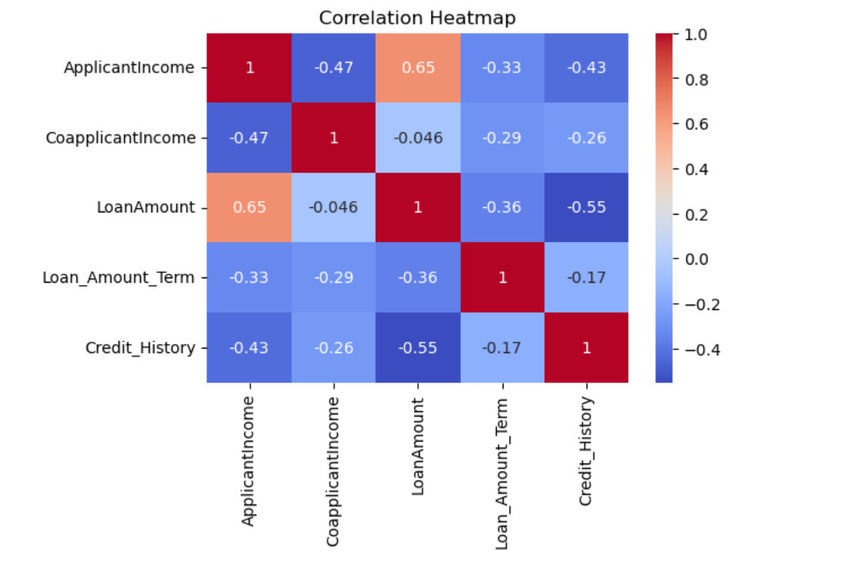
RESULTS AND FINDINGS
The accuracy of the logistic regression model was 82%, slightly higher than that of the random forest classifier, and linear regression which was 80% accurate.
Comparing the logistic regression model to the random forest classifier and linear regression, the former showed slightly higher overall performance in predicting loan approval outcomes. Higher accuracy and precision were attained.
Logistic regression provided interpretability, allowing lenders to understand the factors influencing loan approval decisions.

Slide 7
CONCLUSION
Predictions for house loans are improved by machine learning.
We can predict the outcome of loan approval with a decent degree of accuracy by using logistic regression, linear regression and random forest classifiers.
These models serve as the foundation for understanding the elements impacting loan approvals and can aid lenders in making defensible choices.

Slide 8

THANK YOU!

